Slide 1
Active and Passive Voice

Slide 2
Part of Speech
Noun
Pronoun
Verb
Helping Verb
Adjective
Preposition
Conjunction

Slide 3
Active Voice
John punched Kim
  What is John?
    Subject
  What is punched?
    Verb
      Past
  What is Kim?
    Object

Slide 4
Active Voice
John punched Kim
Who did the action?
  John
What was the action
  Punch
Who was punched?
  Kim

Slide 5
Passive Voice
Kim <was> punched [by] John
Who is the Subject?
  Kim
What is the action?
  Punch
Is there an OBJECT?
  NO
What is “by John”
  AGENT *Agent is the person/thing that do action

Slide 6
Compare and Contrast
John punched Kim
Kim was punched by John
Subject = John
Object = Kim
Action = Punch
Subject = Kim
Object? = NO object
Instead?
Agent = John
Action = Punch

Slide 7
BIG difference
What were in Passive Voice, but not in Active Voice?
  BE VERB and PREPOSITION “BY”
Do you need to put them every time?
  !YES!

Slide 8
Be Verb and Preposition By
BE VERB changes its tense ACCORDING TO?
  The TENSE of the MAIN VERB
What does Preposition “By” do?
  Makes Subject of Active Voice a AGENT
  Agent is a person/thing that do Action(Verb)

Slide 9
PAY ATTENTION
All verbs have 3 different tenses.
  Present tense, Past tense, and PERFECT TENSES
Irregular verbs has different forms of Perfect Tenses
  EAT → ATE → EATEN
  TAKE → TOOK → TAKEN
  WRITE → WROTE → WRITTEN
You MUST change main verb to PERFECT TENSES in PASSIVE VOICE

Slide 10
What do You need to DO?
John punched Kim → Kim was punched by John
Change Subject and Object
  John becomes AGENT, and Kim becomes SUBJECT
You ADD BE verb and change the tense according to main verb
  Between Subject and Main verb
Change Main verb to PERFECT TENSE
Put “BY” after the Main verb
Put Subject of Active Voice after BY

Slide 11
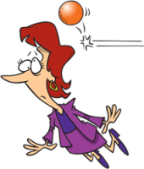
EXERCISE
Describe the picture in Active Voice and Passive Voice in Past Tense

Slide 12
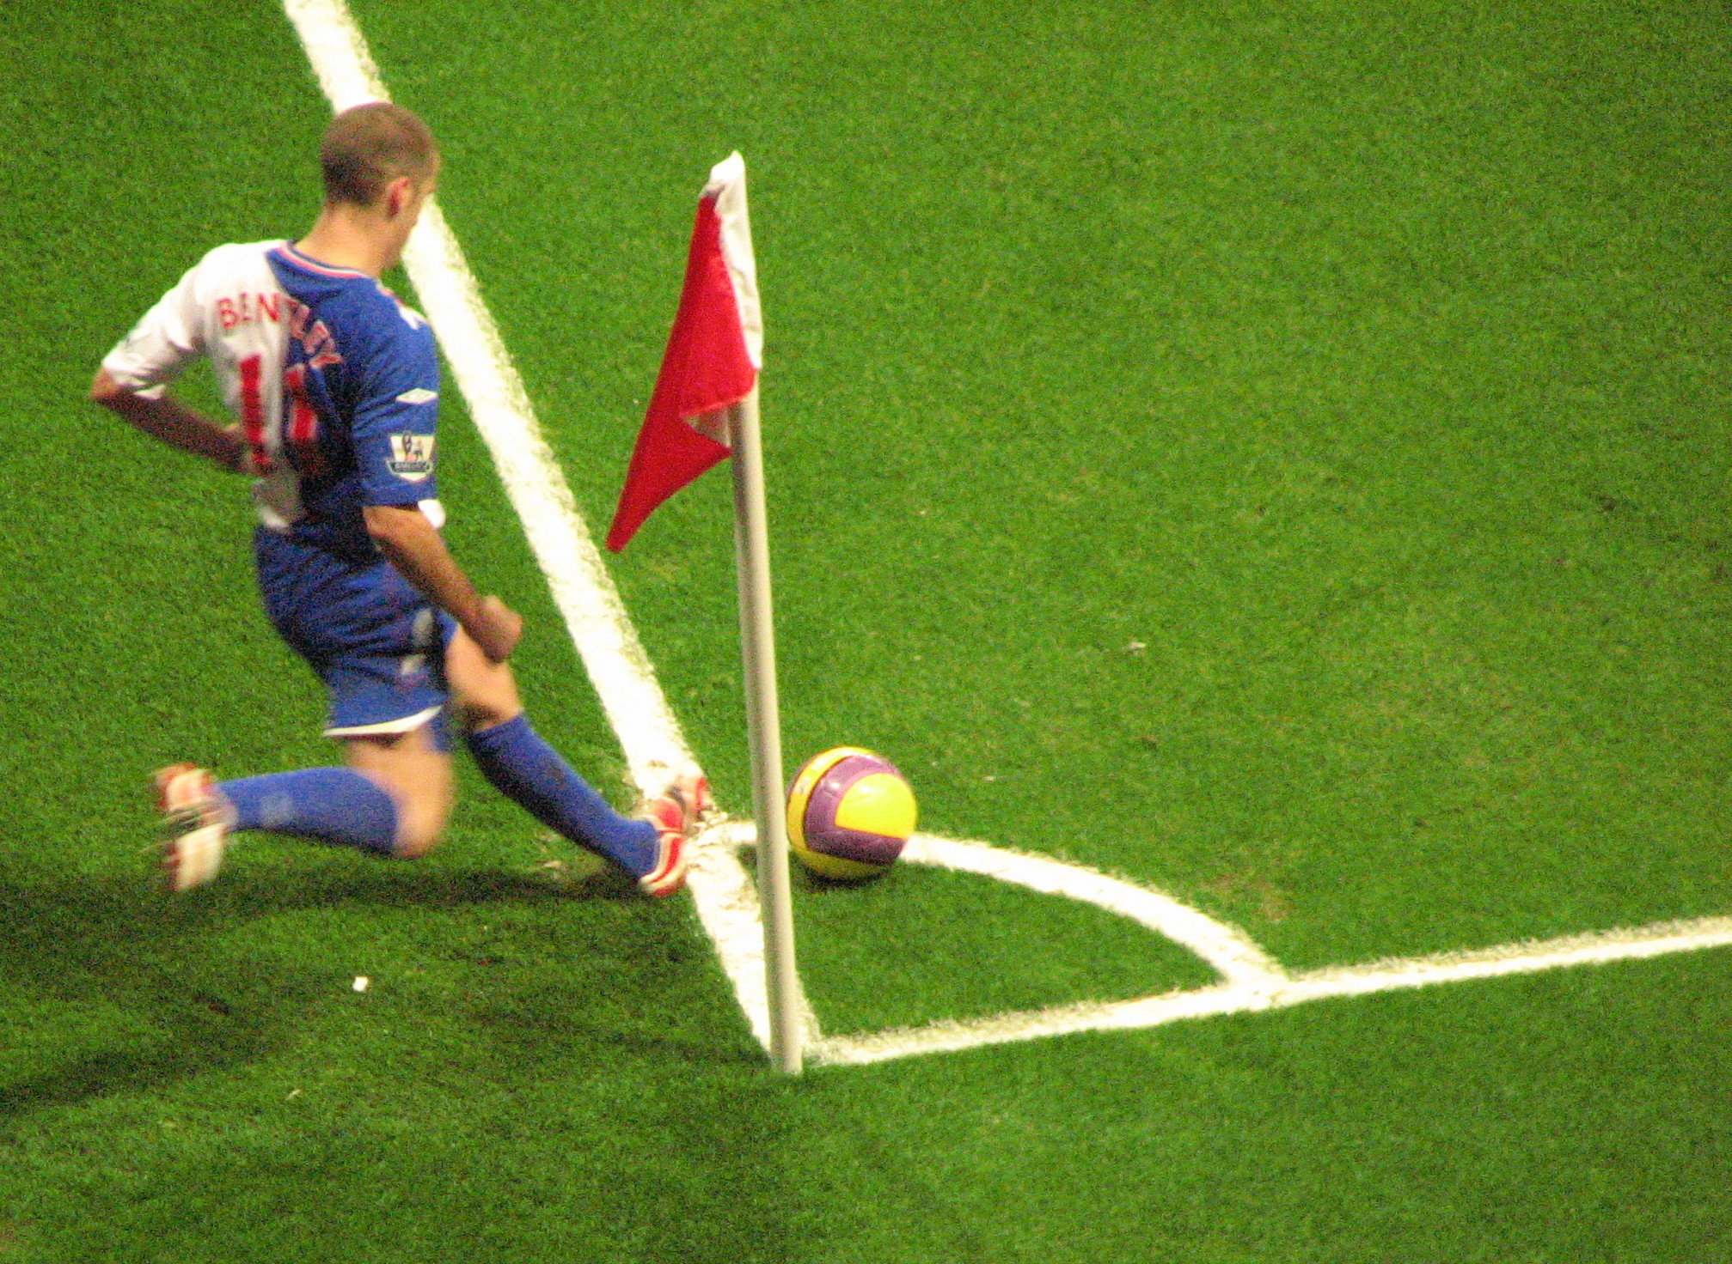
EXERCISE
Describe the picture in Active Voice and Passive Voice in Past Tense

Slide 13
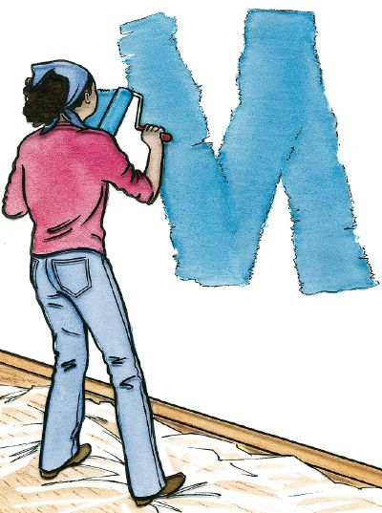
EXERCISE
Describe the picture in Active Voice and Passive Voice in Past Tense

Slide 14

EXERCISE
Describe the picture in Active Voice and Passive Voice in Past Tense

Slide 15

EXERCISE
Describe the picture in Active Voice and Passive Voice in Past Tense

