Slide 2
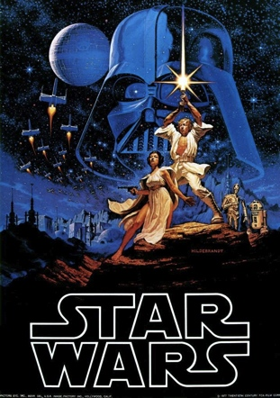
What kind of posters are these?

Slide 3
Do you know?
Do you know how much money did film industry make in 2012 in US and Canada?
$10,800,000,000

Slide 4
Do you know?
Do you know how many people watched at least one movie in 2012?
225,000,000
68% of US/Canada population

Slide 5
Do you know?
Do you know how many movie tickets are sold in 2012?
1,360,000,000
The Motion Picture Association of America
: http://www.mpaa.org/Resources/3037b7a4-58a2-4109-8012-58fca3abdf1b.pdf

Slide 6
In the whole world, 50,000 movies are produced every year.
You will have hard deciding which movie to see since there are so many movies.
What can help people decide which movie to see?
REVIEW!
http://www.themovingarts.com/50000-movies-are-made-every-year-is-that-too-many/

Slide 7
MOVIE REVIEW
Ryota Iwasaki
Kristin Nohara

Slide 8
List your favorite movies as many as possible

Slide 9
Movie Review
Pick ONE favorite movie.
Bullet-Point why you like that movie in 3 minutes.
Share with a person next to you for 2 minutes.
Share means one person reads out loud and another person listens carefully.

Slide 10
Movie Review
Make your bullet-point senteneces into a complete paragraph. You have 3 minutes.
Share your writing with a different person. You have 2 minutes.

Slide 11
Movie Review
Do a final revision with the feedback. You have 3 minutes.

Slide 12
Important elements of Movie review
Read the example movie review and find out What kind of information are in the movie review? You have 3minutes.
Share what you found with a person next to you.
Summary
Evaluations of actors/actresses
Rating with reasons (scale may difer)

Slide 13
Summary
In a summary, you need to include:
Setting
Characters
Key scenes
Do NOT tell the ending, but giving hints builds interest in the readers.
Opinion

Slide 14
Activity 1: SUMMARY
Free-Write a summary of the movie the Pirates of the Caribbean without stopping for 3 minutes.
Read what you wrote, and revise your writing in 3 minutes.
Share with a person next to you for 2 minutes. Read your writing out loud

Slide 15
Evaluation of Performance
Movie reviews often have a evaluation of actor/actresse’s performance.
Key points to consider:
Voice interpretation (Pitch, Quality, Volume)
Body interpretation (Posture, expressiveness)
Understanding of character
Mechanics (Stage movement, use of props)

Slide 16
Activity 2:EVALUATION
http://www.youtube.com/watch?v=CDa5dLDEQio
Evaluate the actor and actress in the balcony scene from Romeo and Juliet.
Share your evaluation with a person next to you.

Slide 17
What are these?
New York TIMES:
★★★★☆ One of the best movies of the 90s!
PEOPLE:
★★★☆☆ Thrilling, Exciting, and Breath- Taking!
RATING

Slide 18
Example Ratings
Good
Bad

Slide 19
Activity 3:RATING
Pick the most recent movie that you watched and give personal rating of that movie.
You need to back up your rating with reasons.
Scale can be your choice. 1-10, 5 star, etc.
Once finished, share with a person next to you.

Slide 20
YOUR Movie Review
Now, write a movie review of the movie that you picked at the beginning of the class.

